Slide 1
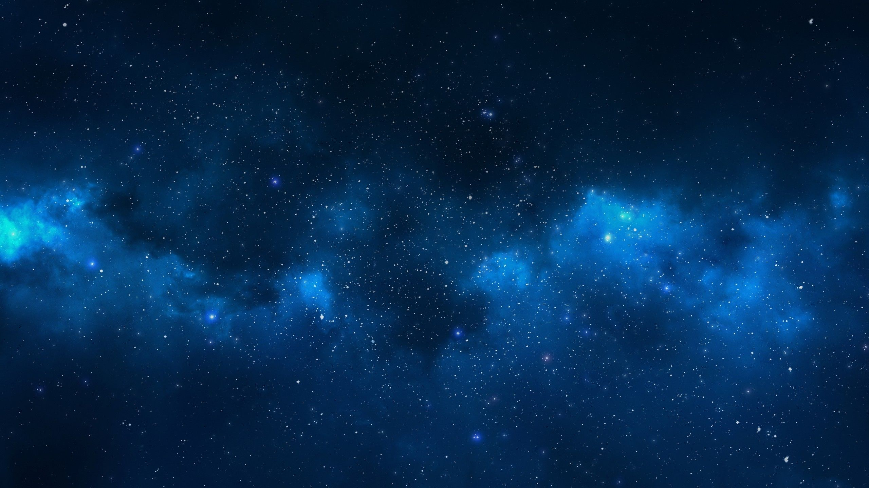
Solving Two Fun Problems With Inhomogeneous Recurrence Relation
Marzieh Roshani
9822403
1399-1400
Notes:
NOTE:
To change the image on this slide, select the picture and delete it. Then click the Pictures icon in the placeholder to insert your own image.

Slide 2
Content List
Hanoi Tower
Myths
Rules
Recurrence relation
Solving the recurrence relation
Final formula
Programming
Real History
Koch Snowflake
Introduction
Construction
Recurrence relation
Solving the recurrence relation

Slide 3
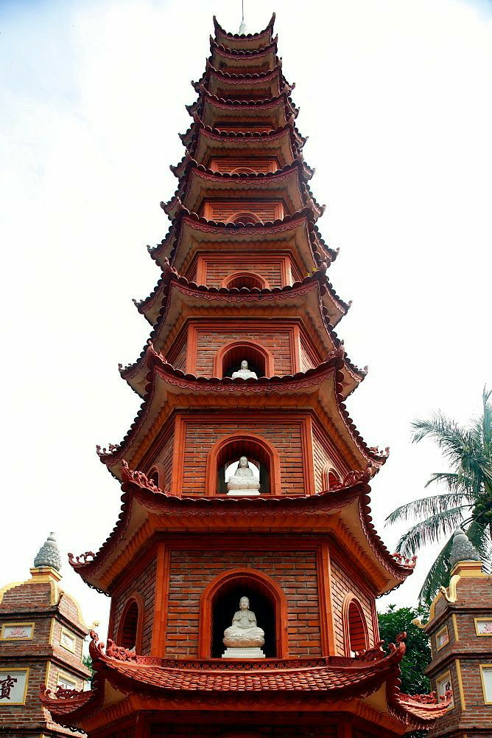
Hanoi Tower

Slide 4
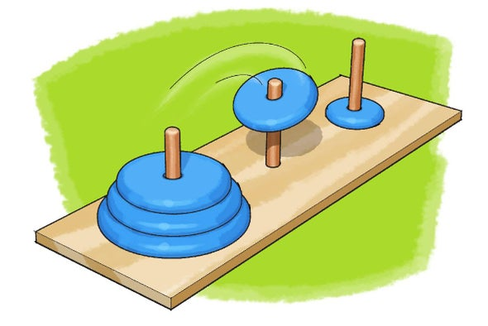
Tower of Hanoi: Myths
The Tower of Hanoi is a famous puzzle, also known as the End of the World Puzzle. There are numerous stories about how it was originated. Legends, tell that at the beginning of time, there was a Hindu temple containing three poles. On one of the poles was a stack of 64 gold discs, each one a little smaller than the one beneath it.
Brahmin priests were assigned to transfer all 64 discs to another pole.
And when the last move of the puzzle is completed, the world would end!
It seems easy right? Actually no. There are some rules to follow.

Slide 5
Tower of Hanoi: Rules
Only one disk can be moved at a time.
No disk should be placed on top of a smaller disk.
Each move consists of taking the upper disk from one of the stacks and placing it on other poles.
1
2
3

Slide 6
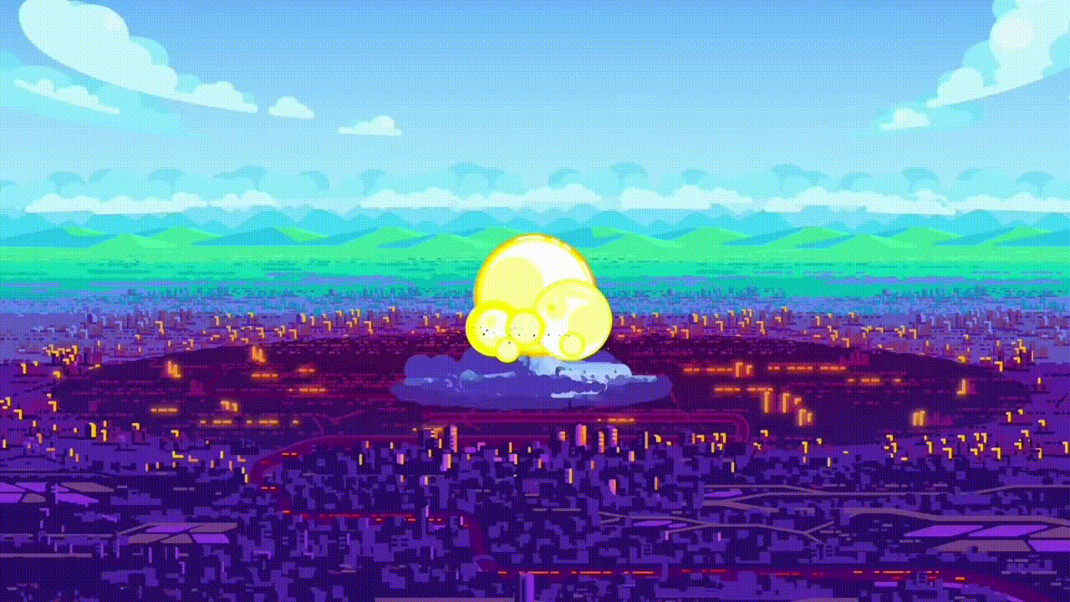
We are going to see how long will it be till the world ends.

Slide 7
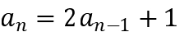
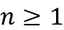
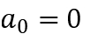
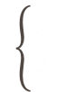
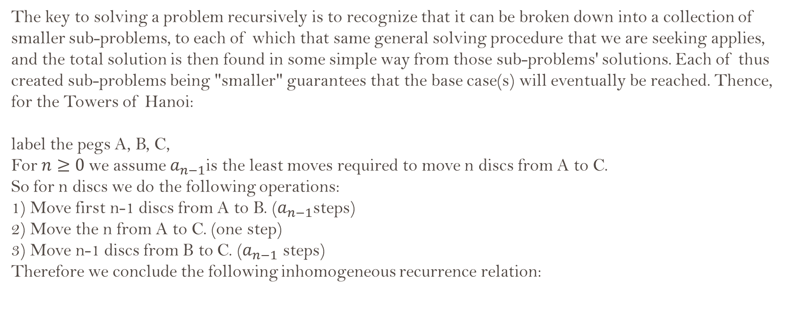
Hanoi Tower: Recurrence relation
The key to solving a problem recursively is to recognize that it can be broken down into a collection of smaller sub-problems, to each of which that same general solving procedure that we are seeking applies, and the total solution is then found in some simple way from those sub-problems' solutions. Each of thus created sub-problems being "smaller" guarantees that the base case(s) will eventually be reached. Thence, for the Towers of Hanoi:
label the pegs A, B, C,
For $n≥0$we assume $a_{n−1}$is the least moves required to move n discs from A to C.
So for n discs we do the following operations:
1) Move first n-1 discs from A to B. ($a_{n−1}$steps)
2) Move the n from A to C. (one step)
3) Move n-1 discs from B to C. ($a_{n−1}$ steps)
Therefore we conclude the following inhomogeneous recurrence relation:
,
$$\left\{\begin{aligned}q \\ q\end{aligned}\right.$$

Slide 8
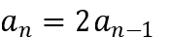
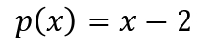
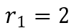
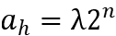
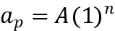
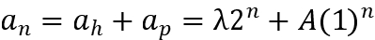
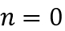
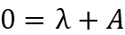
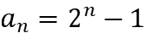
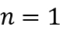
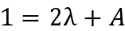

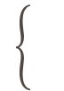

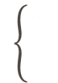


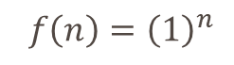


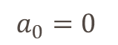

Hanoi Tower: Solving the recurrence relation
$$\underset{⇒}{1}$$
$a_{n}=2a_{n−1}+1$ , $n≥1$
$$\left\{\begin{aligned}q \\ q\end{aligned}\right.$$
$$f\left(n\right)={\left(1\right)}^{n}$$
$$a_{0}=0$$
The homogeneous part gives the solution :
$$\underset{⇒}{1}$$
$$\underset{⇒}{1}$$
$$\underset{⇒}{1}$$
The choice for the particular solution is:
Therefore, we obtain:
$$\underset{⇒}{1}$$
$$\left\{\begin{aligned}q \\ q\end{aligned}\right.$$
$$\underset{⇒}{1}$$
$$\underset{⇒}{1}$$

Slide 9
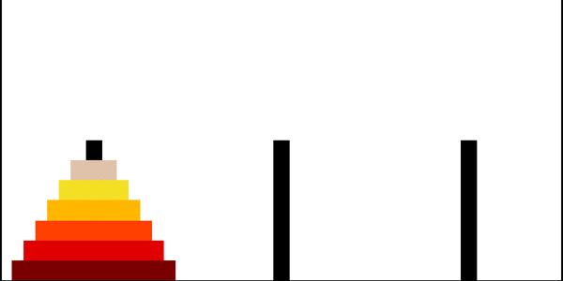
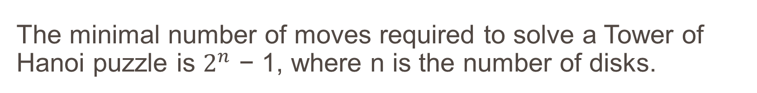
The minimal number of moves required to solve a Tower of Hanoi puzzle is $2^{n}$ − 1, where n is the number of disks.
Hanoi Tower : Final formula

Slide 10
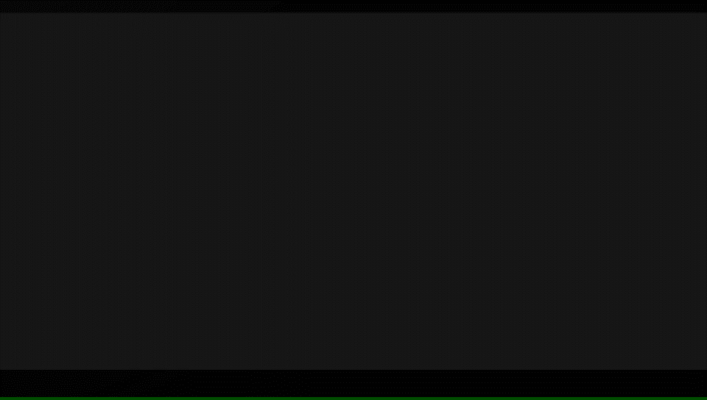
Hanoi Tower : Programming

Slide 11
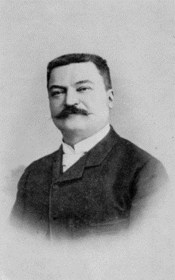
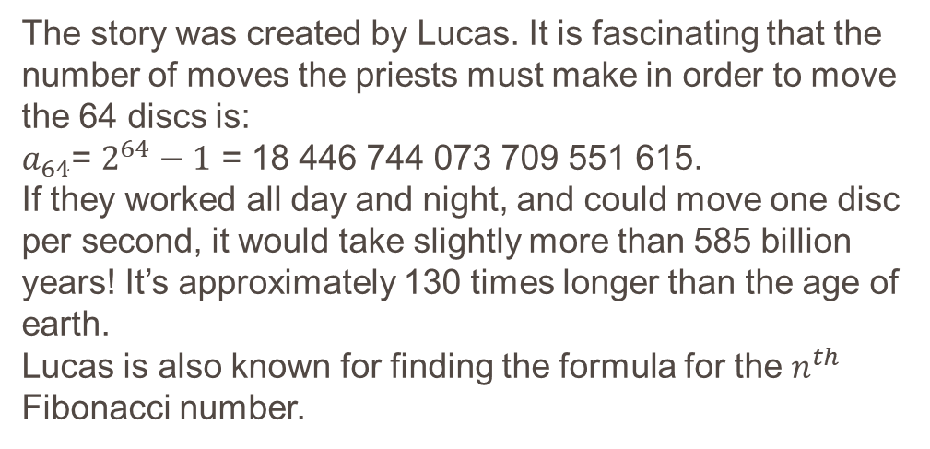
Hanoi Tower : Real History
It is common for people to believe that the Tower of Hanoi puzzle is from ancient Chinese or Hindu origin. But, Edouard Lucas invented it in 1883.
The story was created by Lucas. It is fascinating that the number of moves the priests must make in order to move the 64 discs is:
$a_{64}$= $2^{64}−1$ = 18 446 744 073 709 551 615.
If they worked all day and night, and could move one disc per second, it would take slightly more than 585 billion years! It’s approximately 130 times longer than the age of earth.
Lucas is also known for finding the formula for the $n^{th}$ Fibonacci number.
Edouard Lucas (1842–1891)
French mathematician

Slide 12
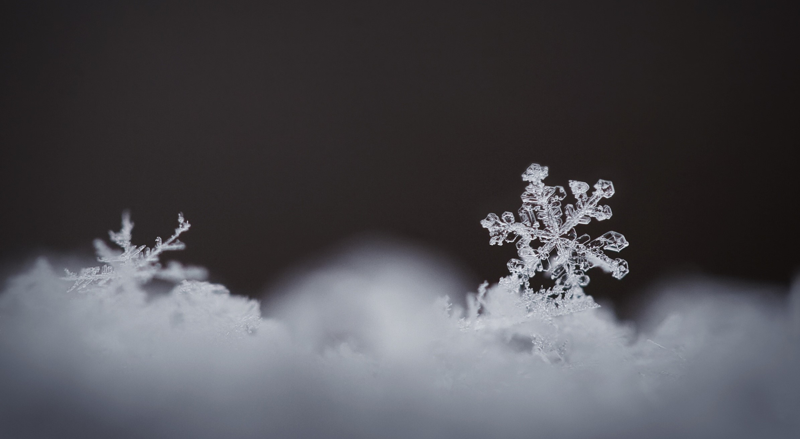
Koch Snowflake

Slide 13
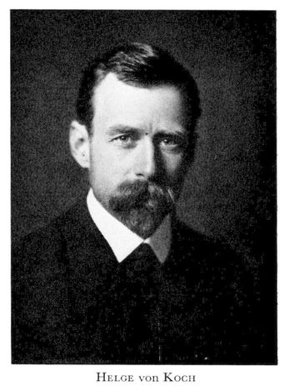
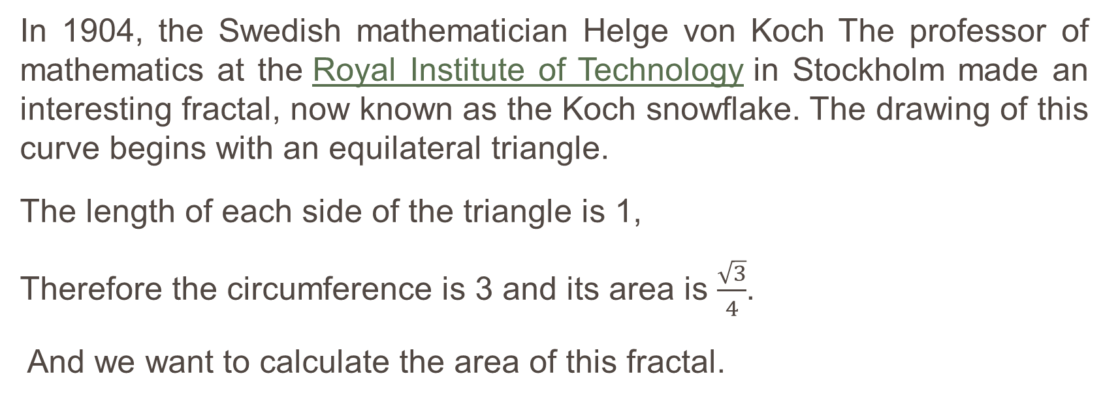
Koch Snowflake: Introduction
In 1904, the Swedish mathematician Helge von Koch The professor of mathematics at the Royal Institute of Technology in Stockholm made an interesting fractal, now known as the Koch snowflake. The drawing of this curve begins with an equilateral triangle.
The length of each side of the triangle is 1,
Therefore the circumference is 3 and its area is $\frac{\sqrt{3}}{4}$.
And we want to calculate the area of this fractal.

Slide 14
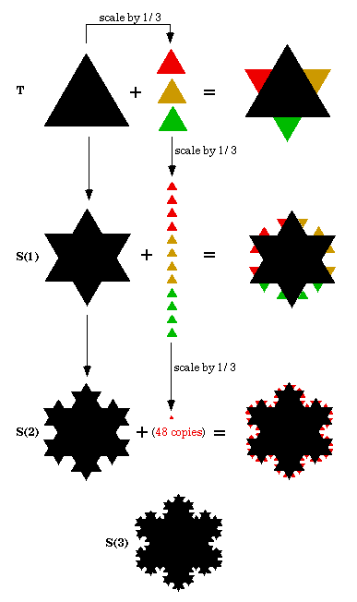
Koch Snowflake: Construction
Divide the line segment into three segments of equal length.
Draw an equilateral triangle that has the middle segment from step 1 as its base and points outward.
Delete the line segment that is the base of the triangle from step 2
Step 1
Step 2
Step 3

Slide 15
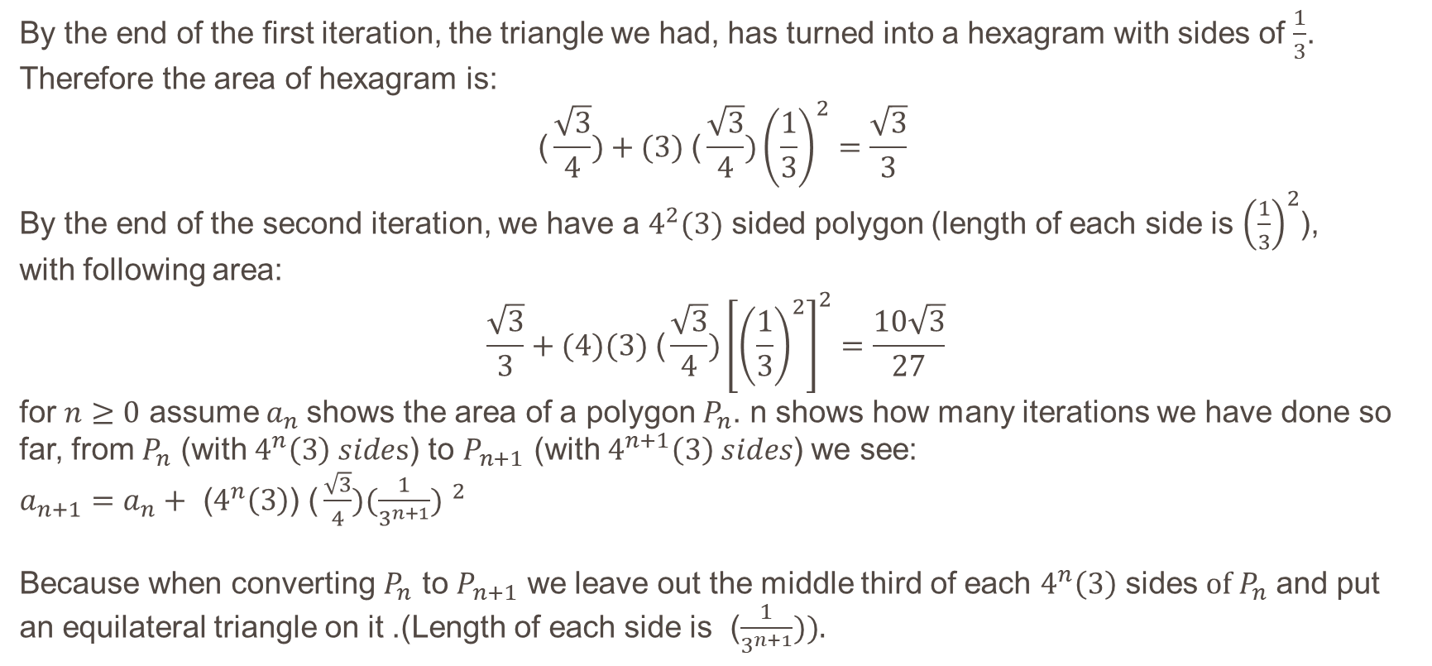
Koch Snowflake: Recurrence relation
By the end of the first iteration, the triangle we had, has turned into a hexagram with sides of $\frac{1}{3}$. Therefore the area of hexagram is:
$$\text{(}\frac{\sqrt{3}}{4})+(3) \text{(}\frac{\sqrt{3}}{4}){\left(\frac{1}{3}\right)}^{2}=\frac{\sqrt{3}}{3}$$
By the end of the second iteration, we have a $4^{2}(3)$ sided polygon (length of each side is ${\left(\frac{1}{3}\right)}^{2}$), with following area:
$$\frac{\sqrt{3}}{3}+(4)(3) \text{(}\frac{\sqrt{3}}{4}){\left[{\left(\frac{1}{3}\right)}^{2}\right]}^{2}=\frac{10\sqrt{3}}{27}$$
for $n≥0$ assume$a_{n}$ shows the area of ​​a polygon $P_{n}$. n shows how many iterations we have done so far, from $P_{n}$ (with $4^{n}\left(3\right) sides$) to $P_{n+1}$ (with $4^{n+1}\left(3\right) sides$) we see:
$a_{n+1}=a_{n}+ \text{(}4^{n}\left(3\right)$) $\text{(}\frac{\sqrt{3}}{4}){(\frac{1}{3^{n+1}}) }^{2}$
Because when converting $P_{n}$ to $P_{n+1}$ we leave out the middle third of each $4^{n}\left(3\right)$ sides$of P_{n}$ and put an equilateral triangle on it .(Length of each side is ($\frac{1}{3^{n+1}})).$

Slide 16
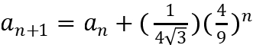
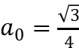
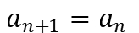
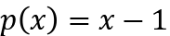
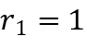
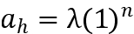
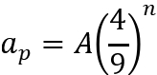
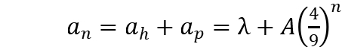


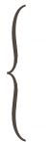

Koch Snowflake: Solving the recurrence relation
$$\left\{\begin{aligned}d \\ d \\ d\end{aligned}\right.$$
The homogeneous part gives the solution :
$$\underset{⇒}{1}$$
$$\underset{⇒}{1}$$
$$\underset{⇒}{1}$$
The choice for the particular solution is:
Therefore, we obtain:

Slide 17
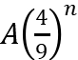
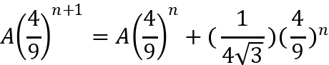
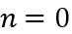
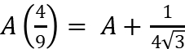
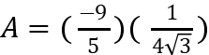
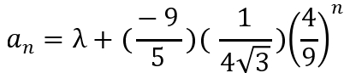
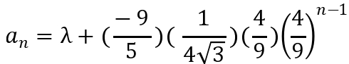




Koch Snowflake: Solving the recurrence relation
Since
is a particular solution of the initial equation, so by placing
we have:
$$\underset{⇒}{1}$$
$$\underset{⇒}{1}$$
$$\underset{⇒}{1}$$

Slide 18











Koch Snowflake: Solving the recurrence relation
$$\underset{⇒}{1}$$
$$\underset{⇒}{1}$$
$$\underset{⇒}{1}$$
,
As n grows we see that
converges to zero and
approaches a finite magnitude of

Slide 19
Sourses
ریاضیات گسسته و ترکیبیاتی گریمالدی جلد دوم
https://www.geeksforgeeks.org/c-program-for-tower-of-hanoi/
https://www.amsi.org.au/teacher_modules/pdfs/Maths_delivers/Induction5.pdf
https://www.youtube.com/watch?v=YstLjLCGmgg

Slide 20

Thank you for your attention
Have a nice winter
Snowflake

